Slide 1



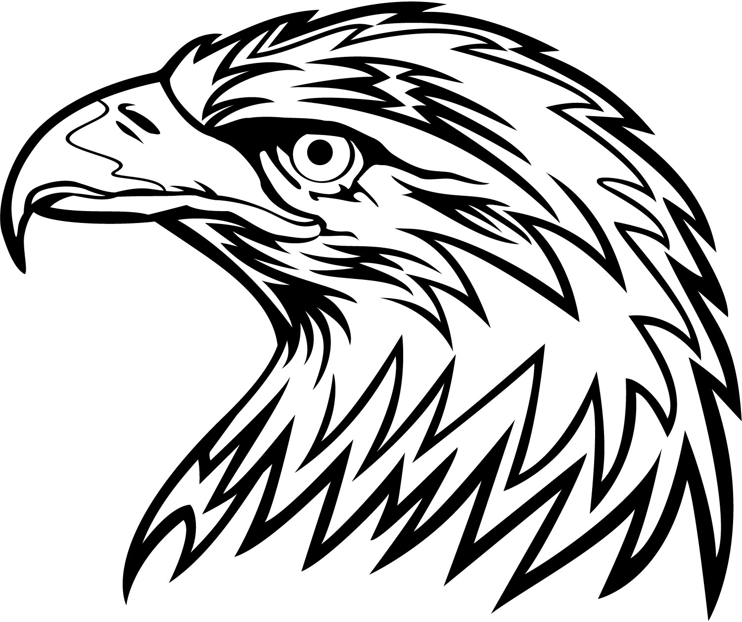
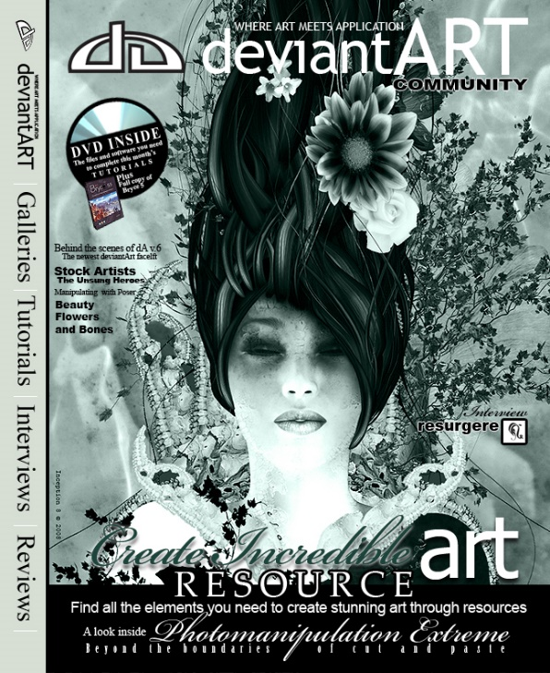
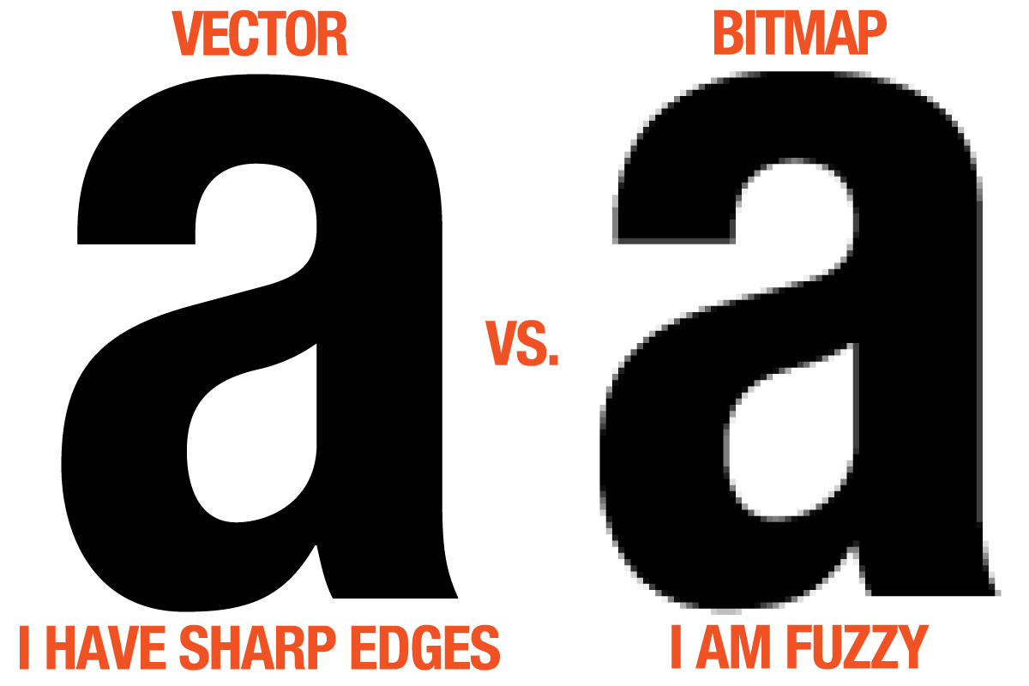
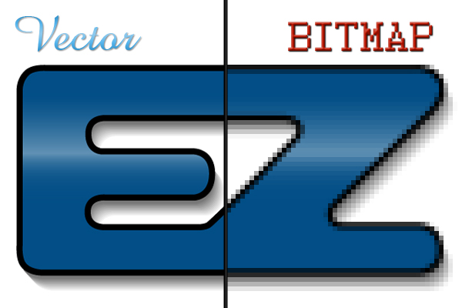

Bitmaps and Vectors

Slide 2
Stop Sign
Purpose: To tell you to stop.
Effect: The colour is red which could represent danger and warning so you will follow what is said on the sign.
Intended Audience: Drivers, it’s a sign telling you to stop for whatever reason.
Type of Graphic: Vector.

Slide 3
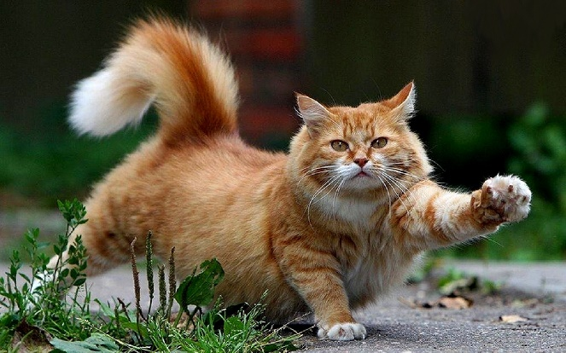
Pictures from a Camera
Purpose: To show what you have found.
Effect: Depends on the photo, the example of the cat is cute but it could be of a rock structure during sunset that could be seen as inspiring or relaxing.
Intended Audience: Again, it depends on the picture, the example would be for people who love cats but if it was a dog then it would be for people who loves dogs.
Type of Graphic: Bitmap

Slide 4

Video Game Character From a Child-Friendly Game Based on a Famous Video Game Series.
Purpose: To have the character more basic for the children playing easier to understand the character’s model.
Effect: As it is a cartoon type of drawing, it is good for children
Intended Audience: Children who want to play video games.
Type of Graphic: Vector

Slide 5
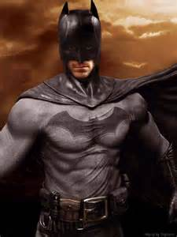
Live Action Movie Character Photos.
Purpose: To show a character from a movie.
Effect: Causes excitement to see what that character does.
Intended Audience: Depends on the character, as Batman has darker colours it is aimed at teens and adults.
Type of Graphic: Bitmap

Slide 6
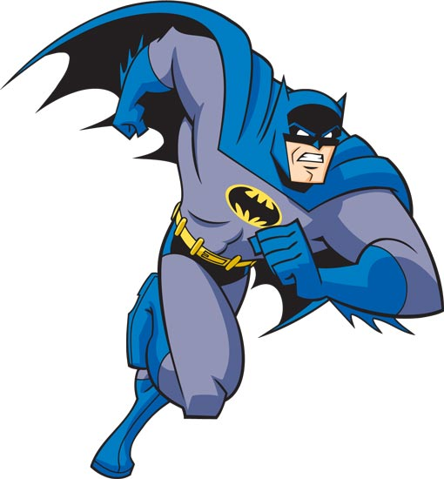
Cartoon Characters.
Purpose: To entertain children watching the show.
Effect: Depends on the character, darker colour can cause you to feel that the character is bad and if it has lighter colours then it could be a good character.
Intended Audience: Cartoons are generally aimed at children.
Type of Graphic: Vector

Slide 7
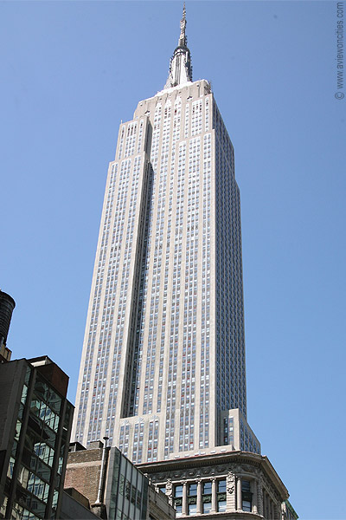
Photo of the Empire State Building.
Purpose: To make people want to visit.
Effect: Makes you want to go as it is so high up.
Intended Audience: All ages.
Type of Graphic: Bitmap

Slide 8

Logos.
Purpose: To attract people to your store/website/company
Effect: Makes you want to see what it is representing if it looks good.
Intended Audience: Anyone using the internet and/or walking around outside.
Type of Graphic: Vector

